Slide 1

Note: The data and information in this document is reflective of a hypothetical situation and client. This document is to be used for KPMG Virtual Internship purposes only.
Sprocket Central Pty Ltd
Data analytics approach
[Division Name] - [Engagement Manager], [Senior Consultant], [Junior Consultant]

Slide 2
Note: The data and information in this document is reflective of a hypothetical situation and client. This document is to be used for KPMG Virtual Internship purposes only.
Agenda
Introduction
Data Exploration
Model Development
Interpretation

Slide 3
Note: The data and information in this document is reflective of a hypothetical situation and client. This document is to be used for KPMG Virtual Internship purposes only.
Introduction
Customer Insights
These are the insight for new customers:
Age Distribution and Analysis
Gender Distribution and Analysis
Job industry category
Number of cars owned by customers
State Analysis

Slide 4
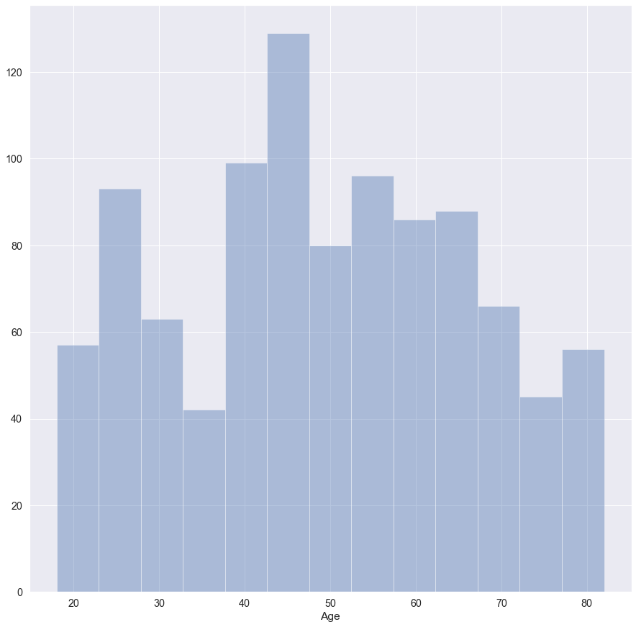
Note: The data and information in this document is reflective of a hypothetical situation and client. This document is to be used for KPMG Virtual Internship purposes only.
Data Exploration
Age Distribution and Analysis
As we can see from this distribution, most customers are between 40 and 65 years old.
The number between 20 and 35 has an average number of customers.
The number of customers between 65 and 80 has a big drop in percentage.

Slide 5
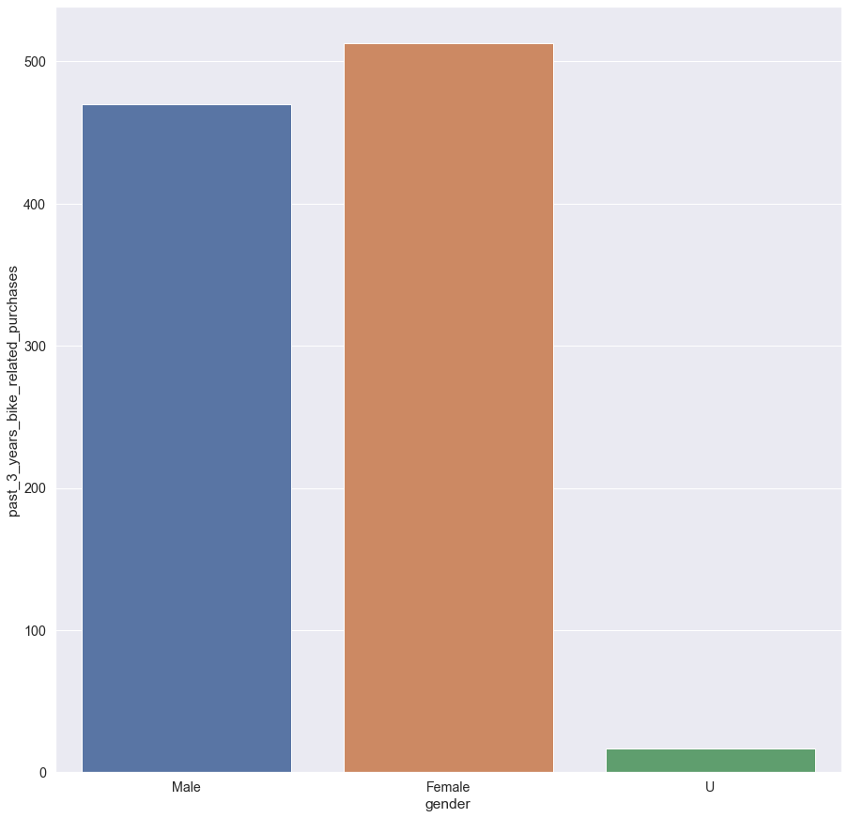
Note: The data and information in this document is reflective of a hypothetical situation and client. This document is to be used for KPMG Virtual Internship purposes only.
Data Exploration
Gender Distribution and Analysis
Females rank first in gender distribution who made a purchase in the past 3-years.
The gap between males and females are not that big.

Slide 6
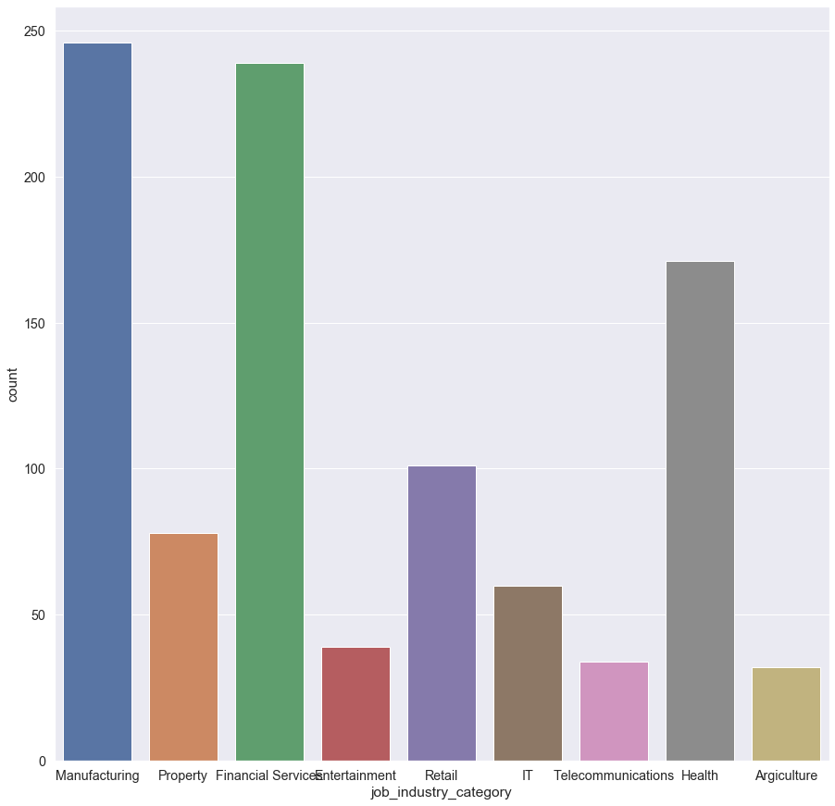
Note: The data and information in this document is reflective of a hypothetical situation and client. This document is to be used for KPMG Virtual Internship purposes only.
Model Development
Job Industry Category
We can conclude from this chart that, most of the customers are from Manufacturing and Financial service department, so If we are building a marketing strategy based on the industry category, we must focus on these two categories more than others.

Slide 7
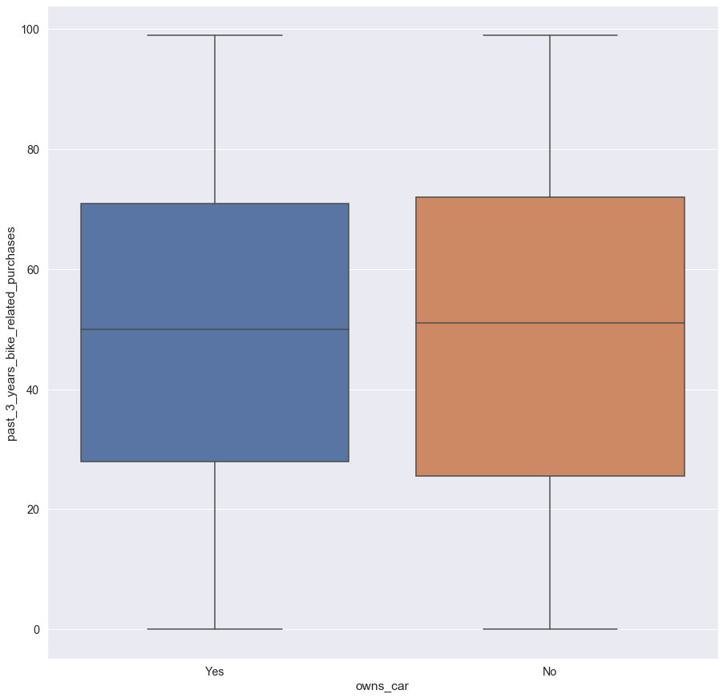
Note: The data and information in this document is reflective of a hypothetical situation and client. This document is to be used for KPMG Virtual Internship purposes only.
Interpretation
Number of cars owned by customers
As we can see from the first figure, customers who don’t have a car have done a slightly more purchases than others in the past 3-years.

Slide 8
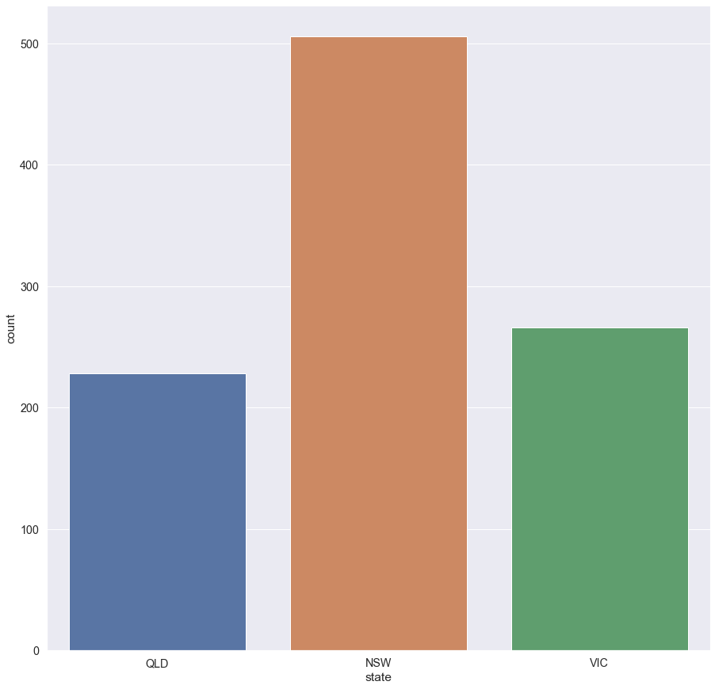
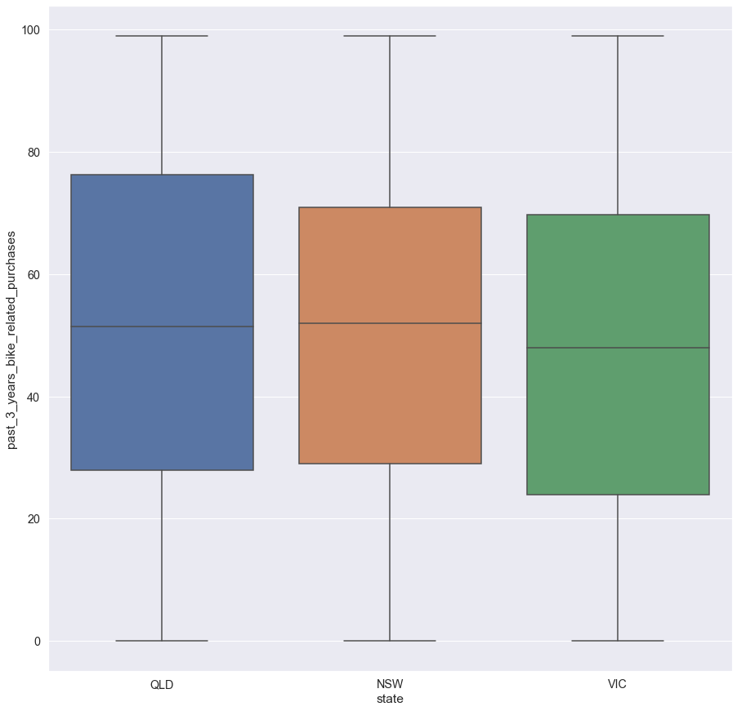
Note: The data and information in this document is reflective of a hypothetical situation and client. This document is to be used for KPMG Virtual Internship purposes only.
Interpretation
State Analysis
As we can see from state distribution, most customer are located on NSW state.
For the second figure, we can see that QLD state payees the biggest purchases, but that not means that most purchases are from this state.

Slide 9
Note: The data and information in this document is reflective of a hypothetical situation and client. This document is to be used for KPMG Virtual Internship purposes only.
Appendix

Slide 10
Note: The data and information in this document is reflective of a hypothetical situation and client. This document is to be used for KPMG Virtual Internship purposes only.
GitHub
https://github.com/AhmedSolimann/KPMG-Data-Analytics-Virtual-Internship

